Slide 1
Homework 4
By Seth LeMar, Stephen Peterson, Bryan Strohmeyer, Anh Nguyen and Santiago Ospina

Slide 2
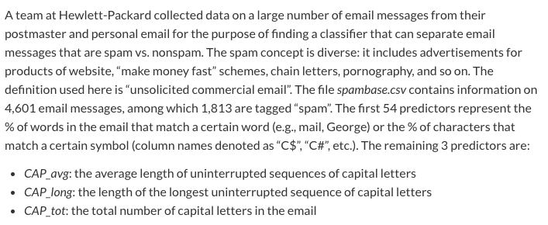
Data Definitions

Slide 3
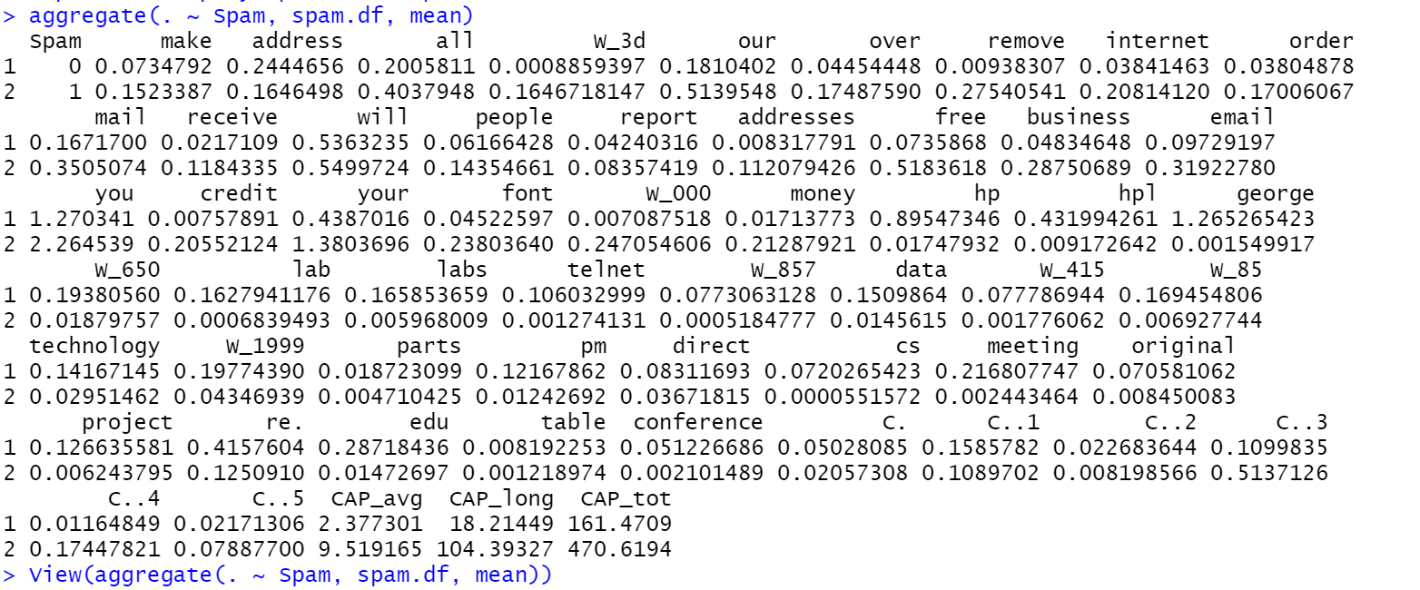
Aggregating the Data
Biggest differences between spam and non-spam emails are in variables: all, our, remove, free, business, email, you, your, W_000, hp, hpl. George, meeting, re., edu
*Picked because they have the biggest difference between the averages of the spam and non-spam segments*
The predictors that occur the most often for spam emails out of the ones we pick are all, our, remove, free, business, email, you, your and W_000

Slide 4
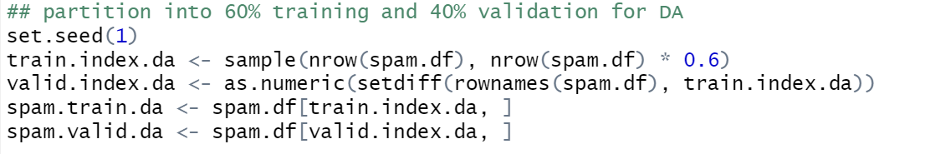
Partition 60/40 for Discriminant Analysis

Slide 5

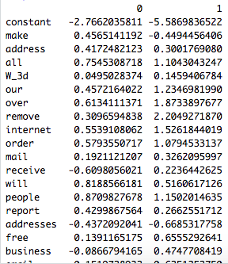
Running Discriminant Analysis
Input:
Output: The coefficients to calculate the Fisher’s Linear Classification function:
LinDA also automatically classifies observations according to aggregated scores.

Slide 6
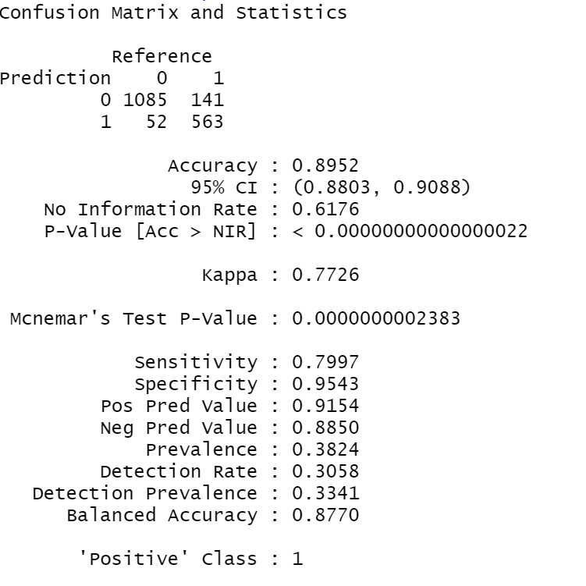
DA Confusion Matrix
The accuracy rate in our spam/no spam confusion matrix is 89.52%
It appears that predicting non spam (0) when it is actually spam (1) is more likely than when it is vice versa which explains the low sensitivity rate

Slide 7
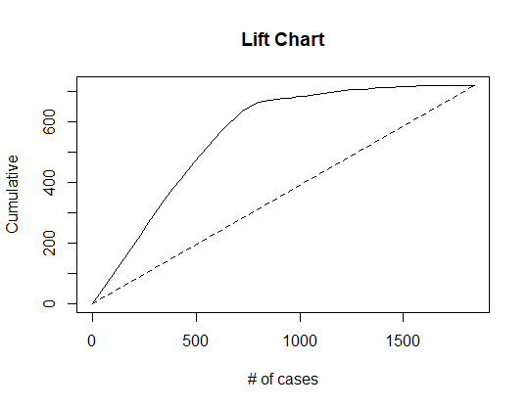
Lift Chart
This chart shows the difference between our model in DA and the naive method. Until about 1,500 cases, out model is significantly higher than the naive method.

Slide 8
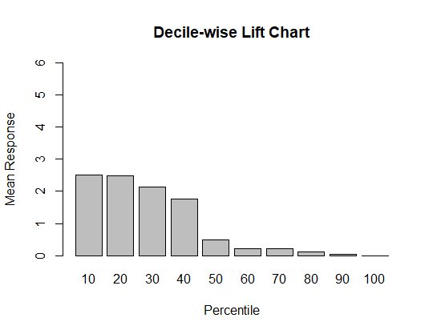
Decile Lift Chart
This chart shows if there is an increase (or decrease) in the likelihood of a response based on choosing the top x percentile of most likely spam emails. If we picked the top 10 or 20 percent of most likely to be spam data, we would be ~2.5 times more likely to receive a 1 as the outcome.

Slide 9
New Email
Given values: mail = 3.77, you = 1.88, money = 1.88, `C;` = 0.264, CAP_avg = 4.333, CAP_long = 13, CAP_tot = 78
-2.8133504161 + 3.77(.2655224971) + 1.88(.5807179556) + 1.88(-.3404665761) + .264(.9629190236) +4.333(.0102739405) + 13(-.0040050621) + 78(.0009783525)
0 predictor score = -.621261
-5.674998937 + 3.77(.472280712) + 1.88(.729074011) + 1.88(.838653556) + .264(-.420634617) + 4.333(.013528337) + 13(-.003672121) + 78(.001842481)
1 predictor score= -.903626
We plugged in each given number with the coefficients from each column and added them together.
Since the outcome is higher for the results of the non-spam formula, that is what it would be classified as.

Slide 10
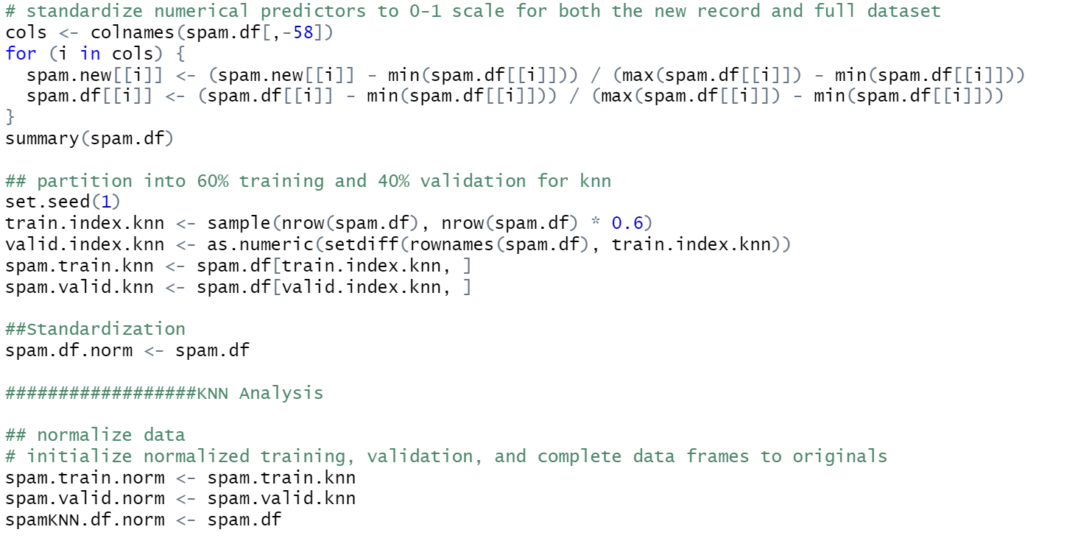
Pre processing for K-Nearest Neighbors
Standardizing and partitioning the data for knn

Slide 11
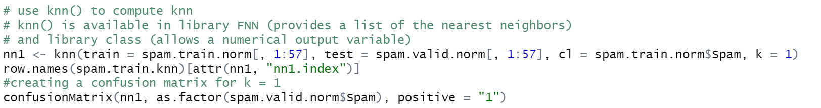
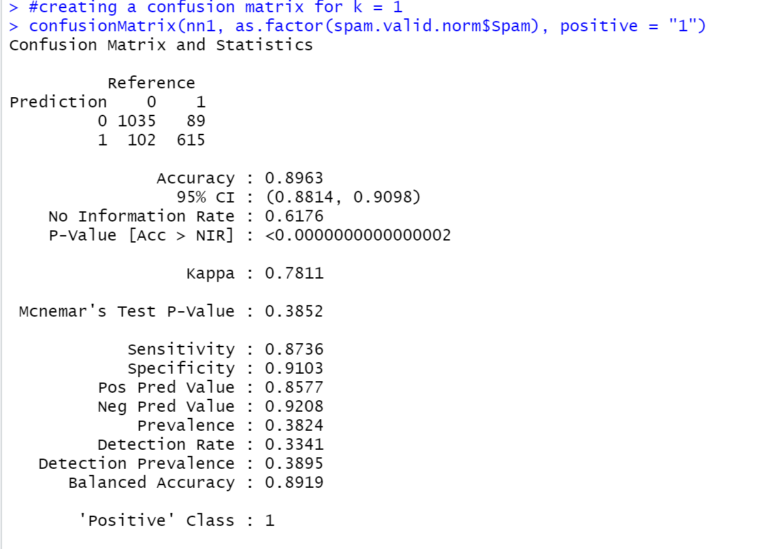
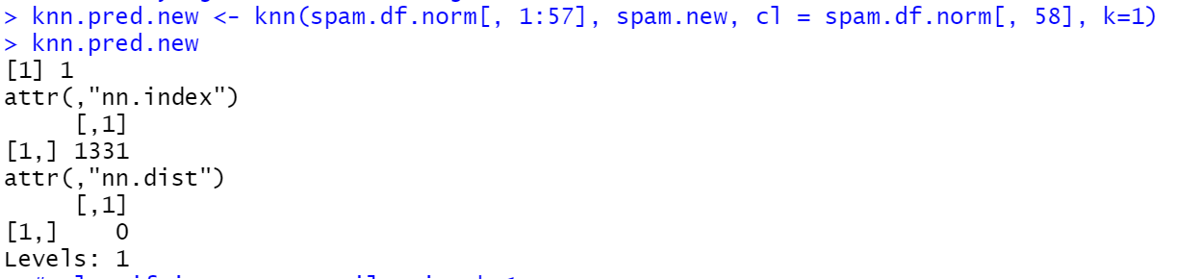
K = 1
89.63% accuracy
27.87% higher than using the naive method ( No information rate )
The example email would be classified as spam in this model
This is because the “Level” section shows a 1

Slide 12
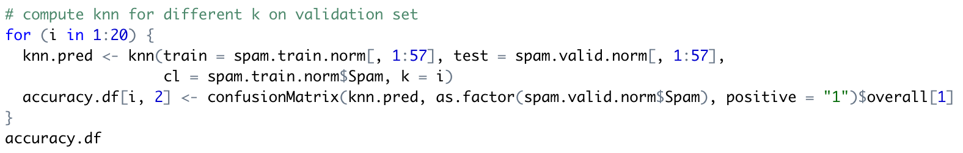
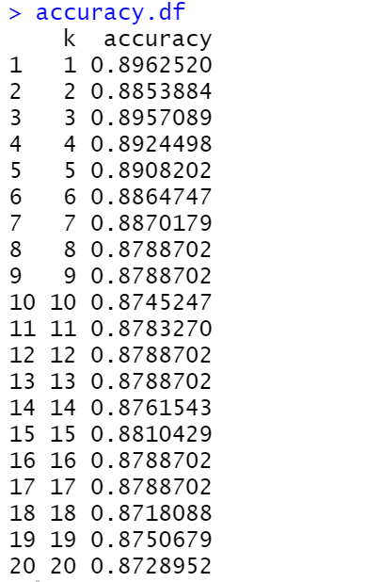
Finding Optimal K
The highest accuracy is actually k=1, but we will analyze the k the provides the second highest accuracy which is k=3
For this data we decided to analyze only k=1 and k=3.
In a real world situation we would analyze many more since a lot of the Ks provide similar accuracies but for this assignment we will be doing the two most accurate.

Slide 13
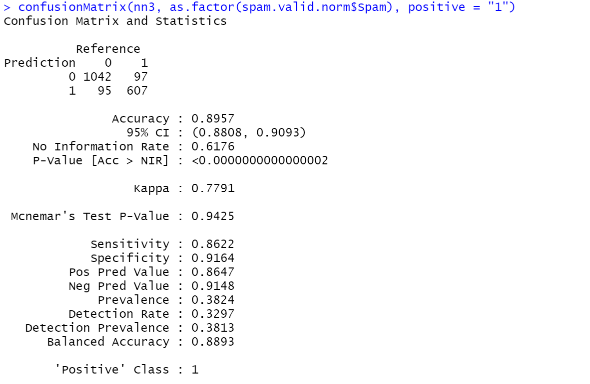
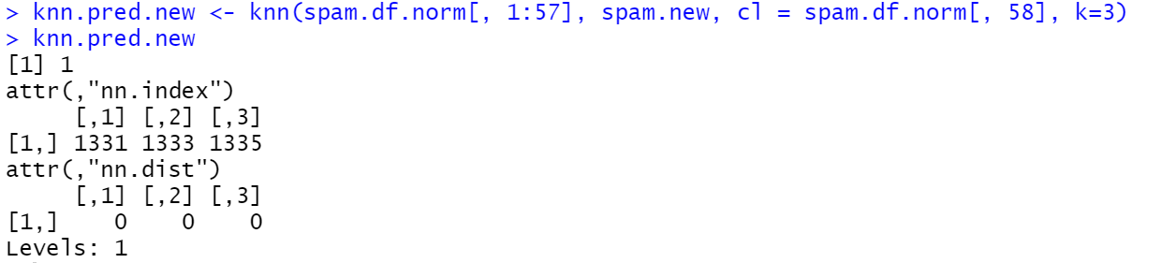
Best K (K = 3)
The best K (besides K=1) is 3 based on accuracy
This model is 89.57% accurate
27.81% higher than naive method
Lower true positive rate (sensitivity) than k=1
Higher true negative rate (specificity) than k=1
The example email would be classified as spam in this model
This is because the “Level” section shows a 1

Slide 14
Comparison Table
 | Accuracy | Sensitivity | Specificity
Discriminant Analysis | 89.52% | 79.97% | 95.43%
k-Nearest Neighbors k=1 | 89.63% | 87.36% | 91.03%
k-Nearest Neighbors k=3 | 89.57% | 86.22% | 91.64%

Slide 15
Summary
The model that is best for predicting spam emails is k-Nearest Neighbors with a k of 1. The reason for this is because of its accuracy and true positive rate. All 3 of the models are very close in terms of the accuracy but the discriminant analysis sensitivity is way too low and creates a large imbalance of responses. Both of the k-Nearest Neighbors models that we tested are very close but since k=1 is slightly more accurate, k=1 is the best model for predicting.

